Slide 1
IBM University Engagement Project Submission
“Exploring the Power of Agentic AI with IBM Granite and IBM Bob”

Slide 2

Project Tile – Network Intrusion Detection
Domain of Project – Cybersecurity / Network Security /ML
Student Name | Recent Passport Photo | Email ID | Mobile number [WhatsApp]
DHIVAGAR S |  | dhivagar1967@gmail.com | 9842229987

Slide 3
Problem Statement -
Problem Statement : Network Intrusion Detection Agent
The Challenge
Modern networks face a constant stream of cyberattacks — DoS, Probe, R2L, and U2R intrusions — hidden inside massive volumes of traffic. Manual monitoring, delayed detection, and high false-positive rates overwhelm security teams. Information about traffic patterns and attack signatures is scattered and reactive. Without real-time, automated classification, many networks fail to detect intrusions before damage occurs.
The Objective
Build an AI-powered Network Intrusion Detection Agent that delivers real-time traffic classification and threat insights for security analysts and network administrators. The solution should:
Personalized Diet Plans – Recommend meals based on age, health conditions, allergies, cultural preferences, and fitness
Traffic Classification – Classify network flows as Normal or Attack, with attack sub-type (DoS, Probe, R2L, U2R)
ML Model Pipeline – Preprocess and analyze traffic using a model trained on the NSL-KDD dataset
Real-Time Detection & Feedback – Allow users to upload or stream traffic data and get instant classification results
Multi-Agent System –
Traffic Analysis Agent (preprocesses and extracts features from network traffic)
Intrusion Classification Agent (predicts Normal/Attack and attack type)
Alert & Advisory Agent (flags high-risk detections and suggests response actions)
Deployment Agent (serves the model via Flask/Streamlit on IBM Cloud Lite
Visualization Dashboard – Show detection results, attack-type breakdown, and model confidence in real time

Slide 4
Proposed Solution -
Proposed Solution: AI-Powered Nutrition Agent
The proposed solution is a multi-agent AI-powered Network Intrusion Detection Agent built using IBM Bob, IBM watsonx.ai, and Granite Models to provide real-time traffic classification and threat insights. The system addresses challenges in manual monitoring, delayed detection, and high false-positive rates through an intelligent, modular architecture. At its core, the solution uses a machine learning classification pipeline trained on the NSL-KDD dataset to detect and classify network traffic, enabling the system to identify Normal traffic versus Attack traffic and its sub-type using trained classification algorithms. The system consists of four key agents: the Traffic Analysis Agent, which preprocesses raw network traffic and extracts relevant features for classification; the Intrusion Classification Agent, which predicts whether traffic is Normal or an Attack (DoS, Probe, R2L, U2R) using the trained ML model; the Alert & Advisory Agent, which flags high-risk detections and suggests appropriate response actions; and the Deployment Agent, which serves the model in real time via Flask/Streamlit hosted on IBM Cloud Lite. The solution includes a user-friendly dashboard (built with Streamlit or React) that visualizes traffic classification results, attack-type breakdown, and model confidence in real time. IBM Bob is used to orchestrate agent workflows, while watsonx.ai ensures scalable model deployment, monitoring, and AI governance, and Granite models power reasoning and alert generation.

Slide 5
Technology Used
IBM Bob platform - For designing and orchestrating multi-agent workflows visually
IBM Granite model - for eg – ibm-granite-3-2-8b – For natural language understanding, reasoning, and generating alert summaries
IBM Cloud – It provides the infrastructure to build, deploy, and scale the Intrusion Detection Agent efficiently. IBM Cloud enables a reliable, secure, and scalable environment for deploying the model.
ML Classification Pipeline – Trained model (Random Forest/similar) on the NSL-KDD dataset to classify traffic as Normal or Attack, making the detection agent accurate and effective.
IBM Watsonx.ai - For model deployment, monitoring, and AI governance
Flask/Streamlit – For building the real-time interface where traffic data is uploaded and classification results are displayed

Slide 6
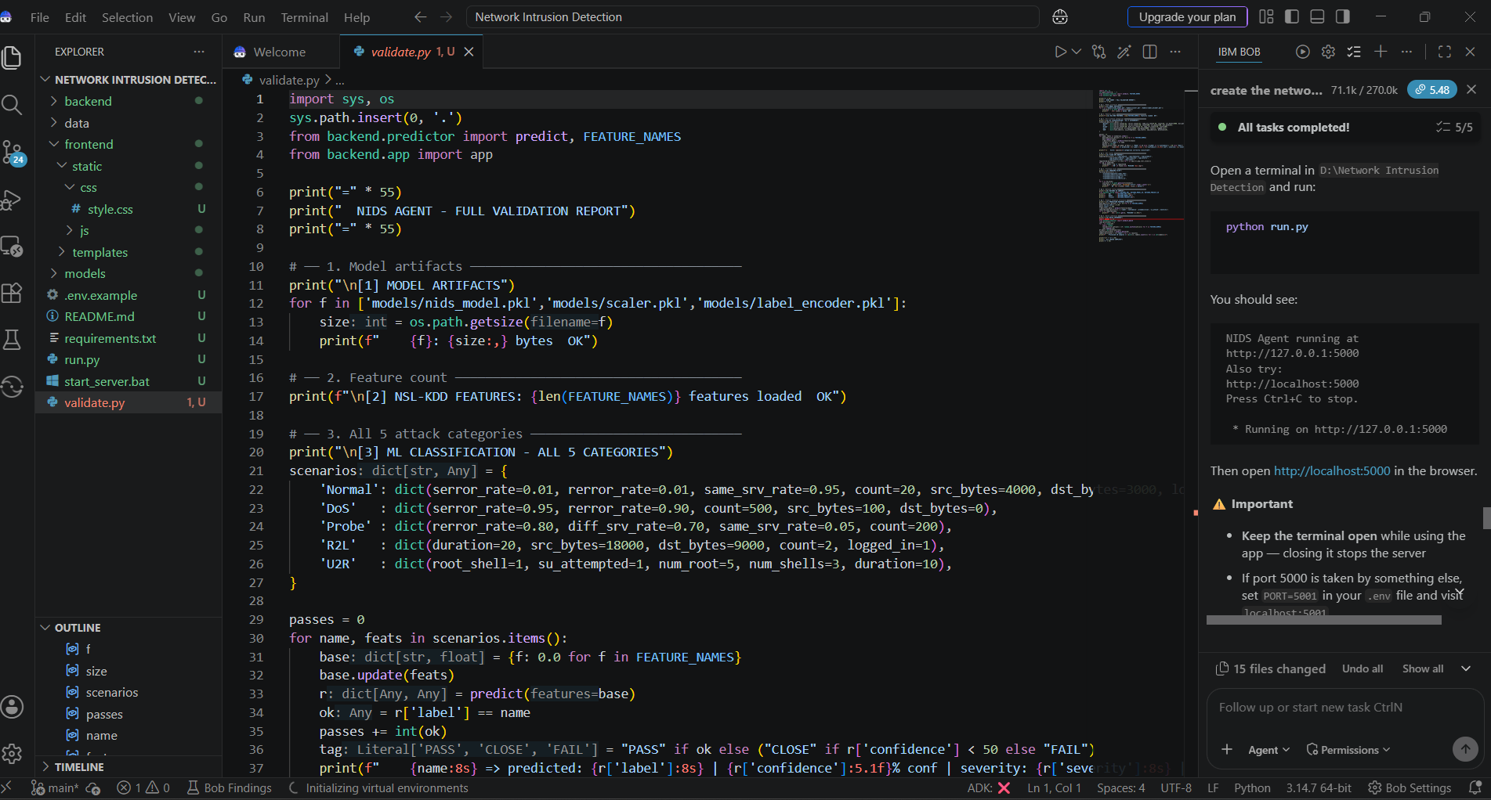
Required Files created using IBM bob -

Slide 7
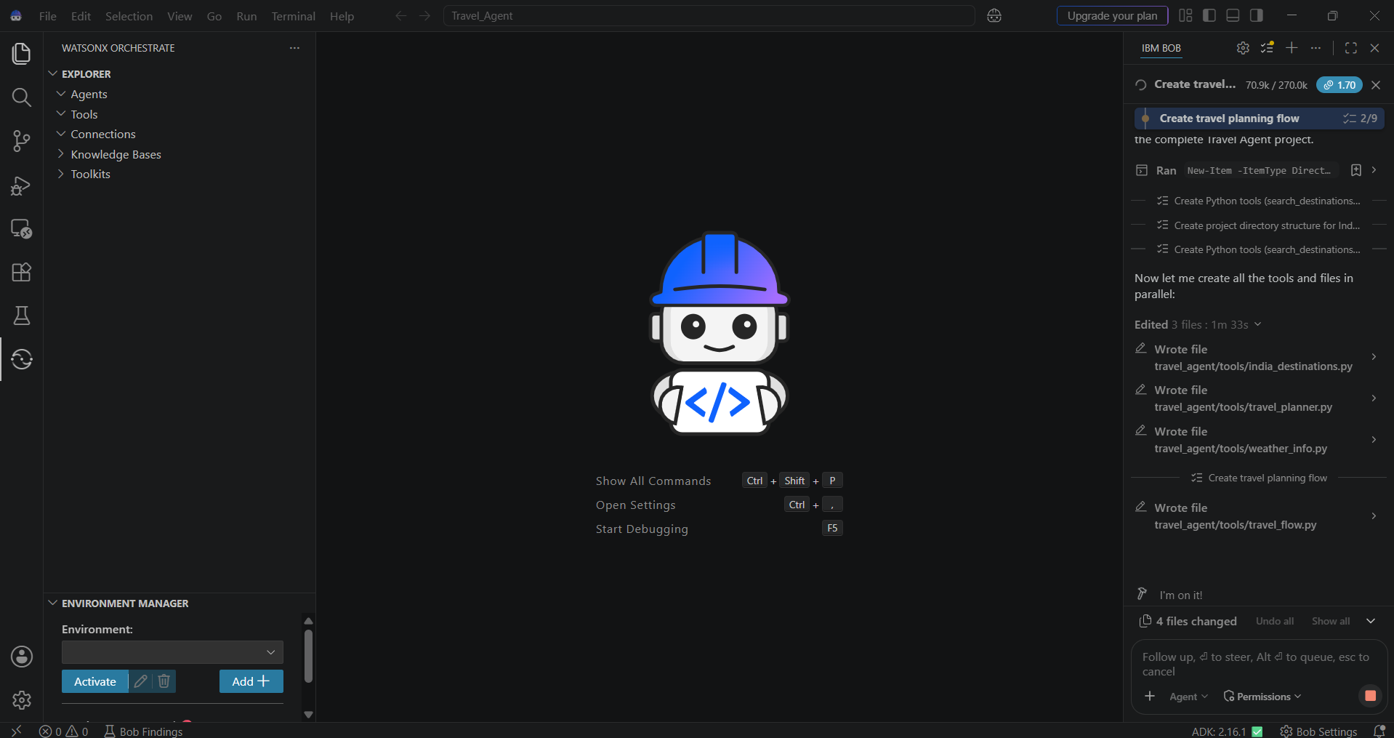
IBM Bob Screenshots:

Slide 8
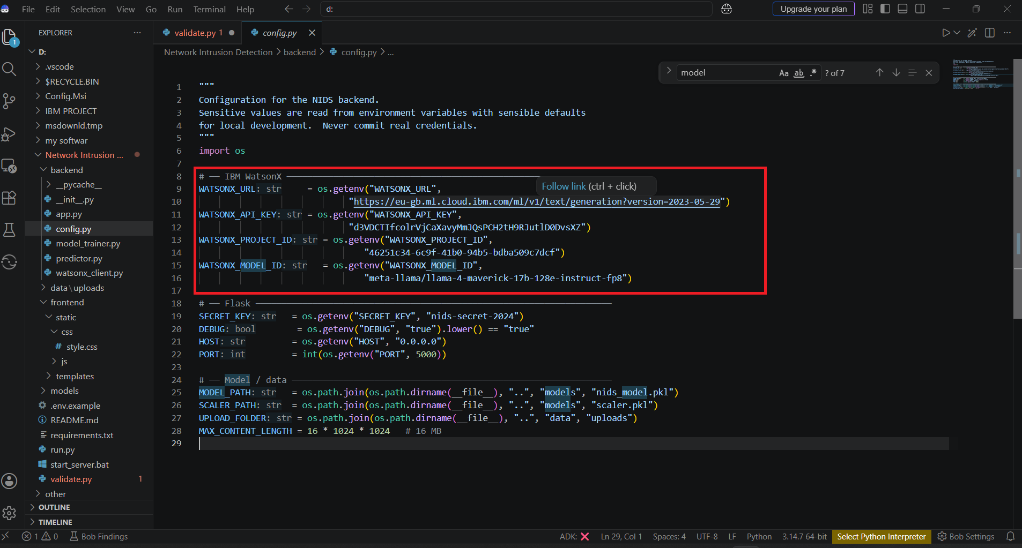

Slide 9
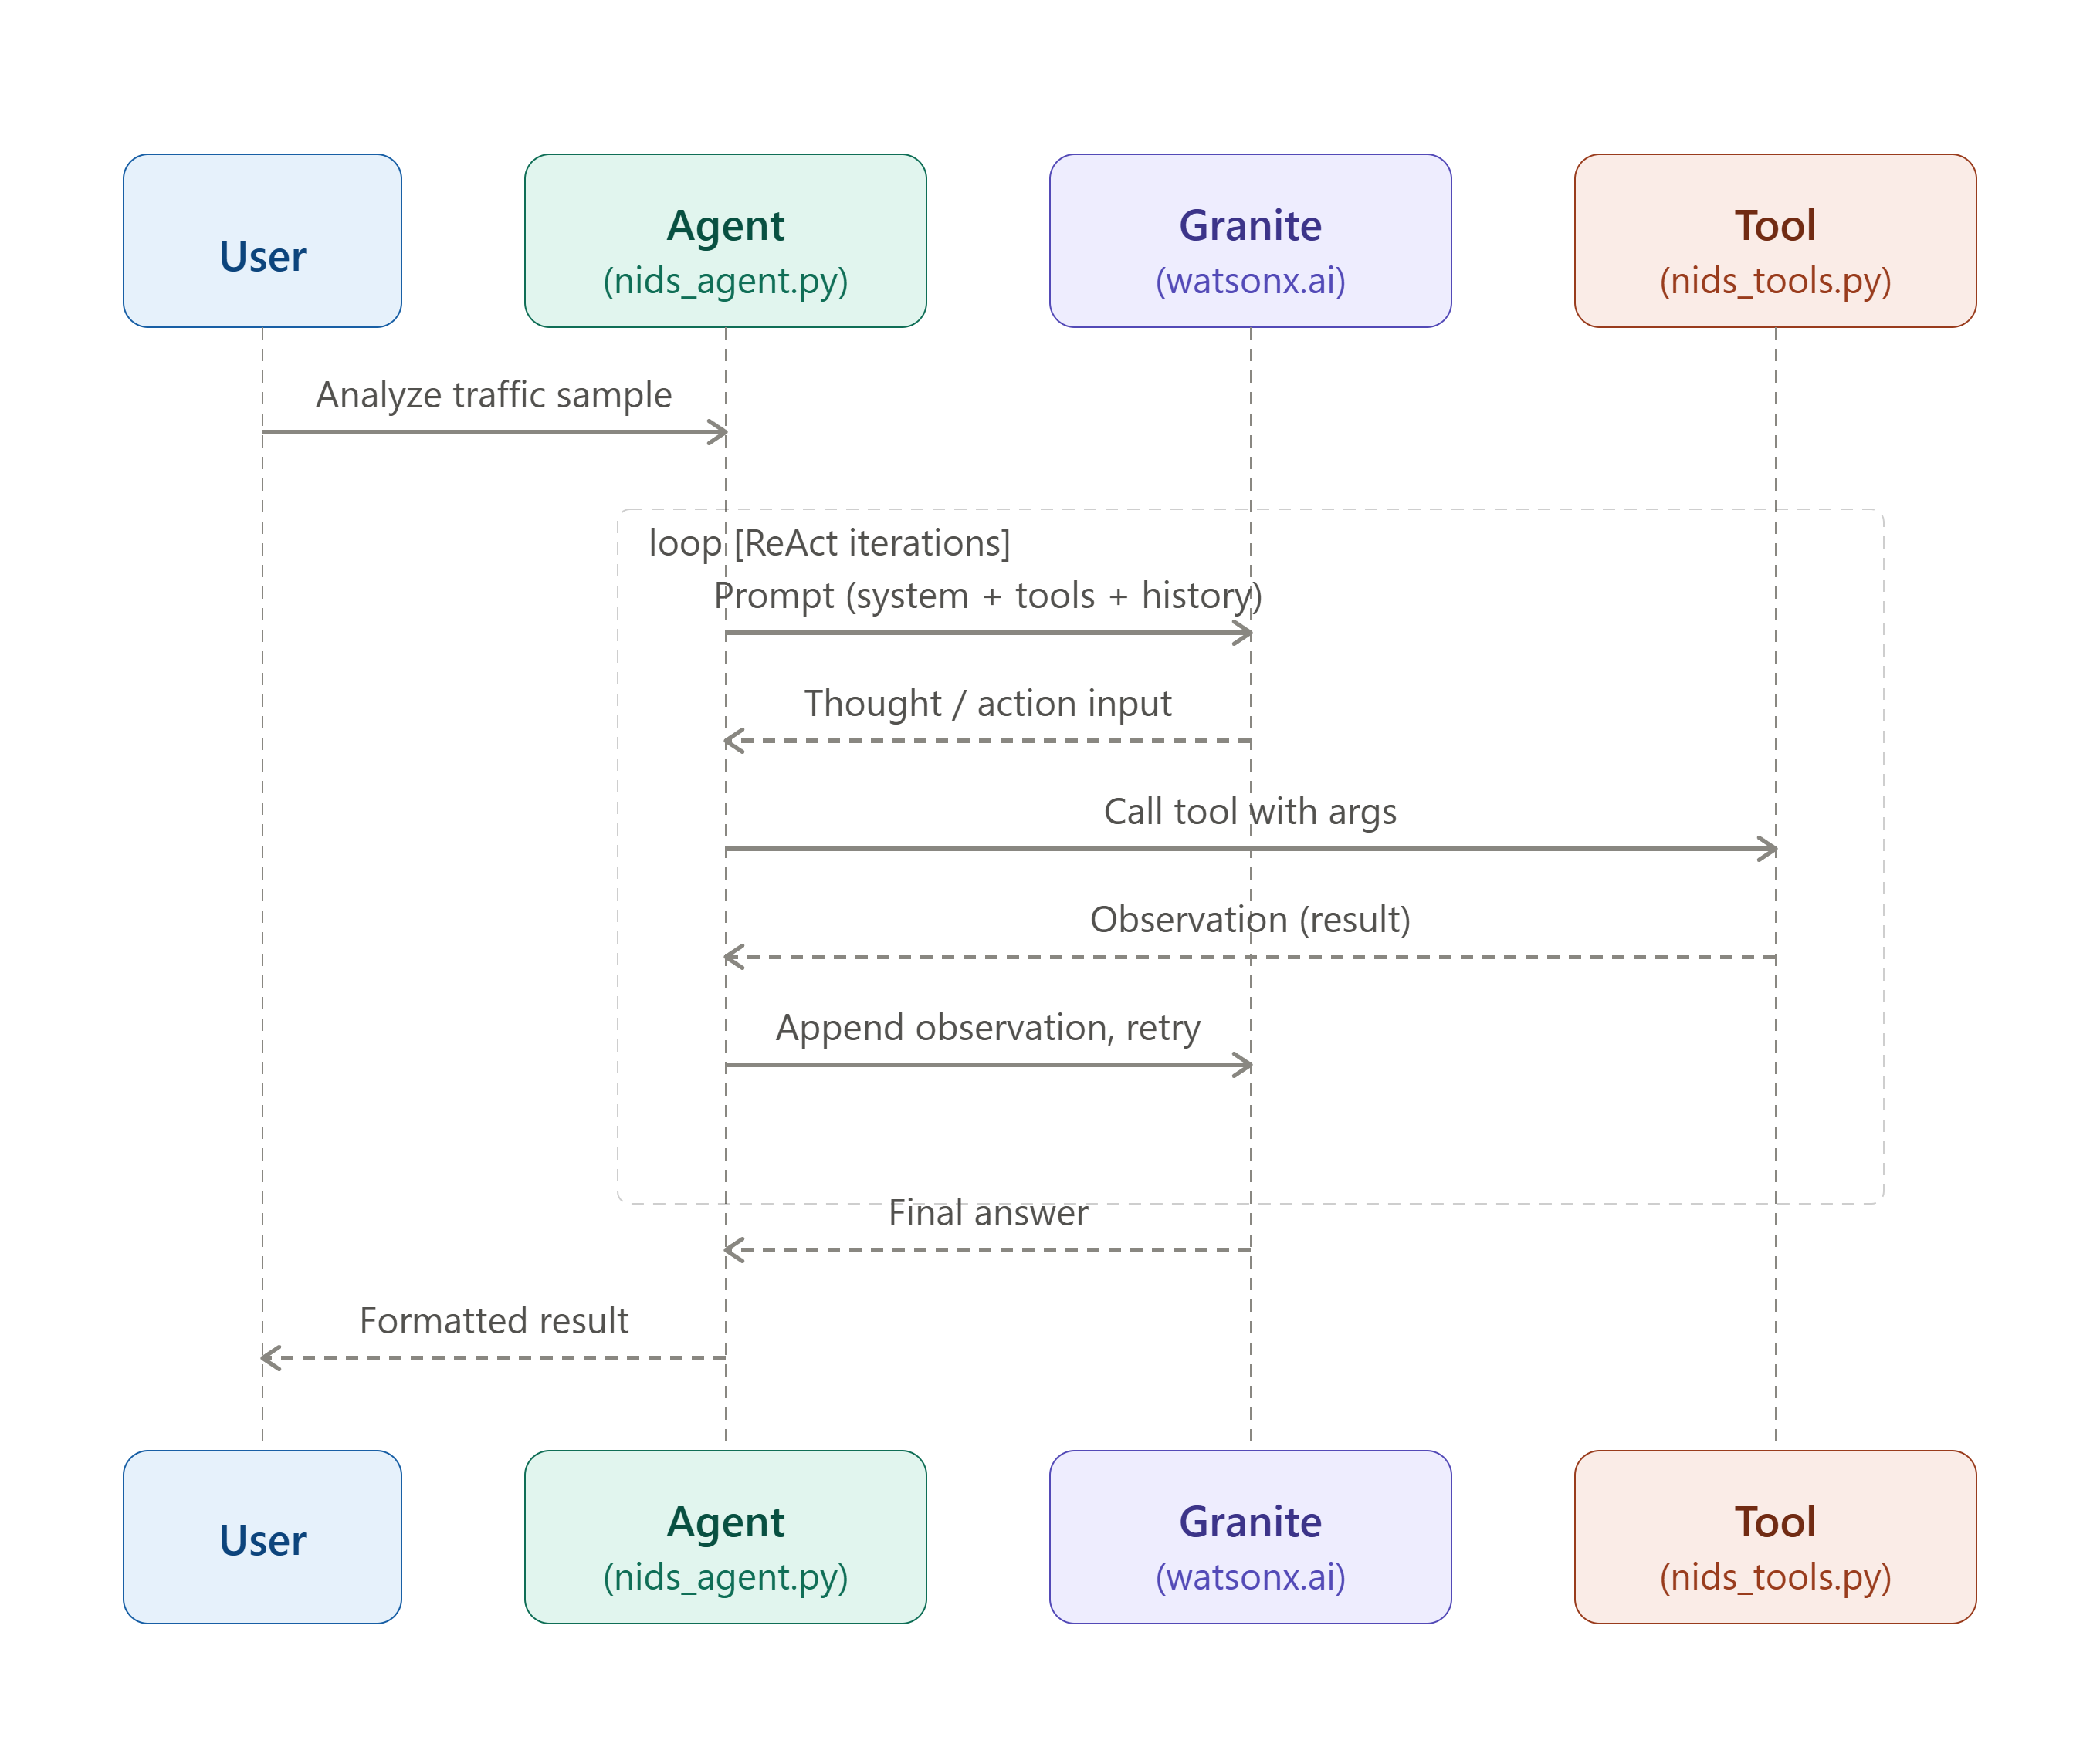
Architecture blueprint for IBM bob:

Slide 10

Role of Agentic AI in the solution
Agentic AI enables the Intrusion Detection system to function as an intelligent, autonomous system rather than a simple classifier. Using IBM watsonx.ai and IBM Granite models, it coordinates multiple specialized agents to deliver real-time threat detection and response guidance. Each agent performs a specific role — such as extracting traffic features, classifying attack types, and generating alerts — while working collaboratively, and this multi-agent approach ensures efficient task execution and accurate results. Agentic AI also brings context awareness, understanding traffic patterns like protocol type, connection duration, and byte counts to generate accurate classifications, and it supports real-time adaptation by continuously updating detection decisions based on incoming traffic data. Additionally, agents communicate with each other, enabling better decision-making and improved outcomes. Overall, Agentic AI makes the system proactive, autonomous, and threat-driven, acting like a smart digital security analyst that helps protect networks from intrusions in real time.

Slide 11
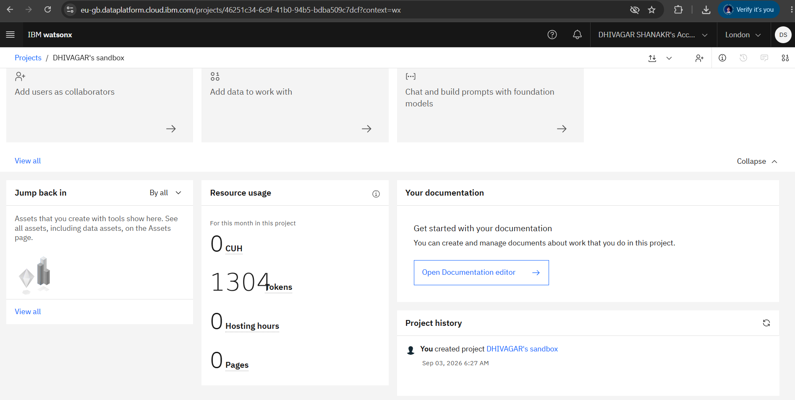
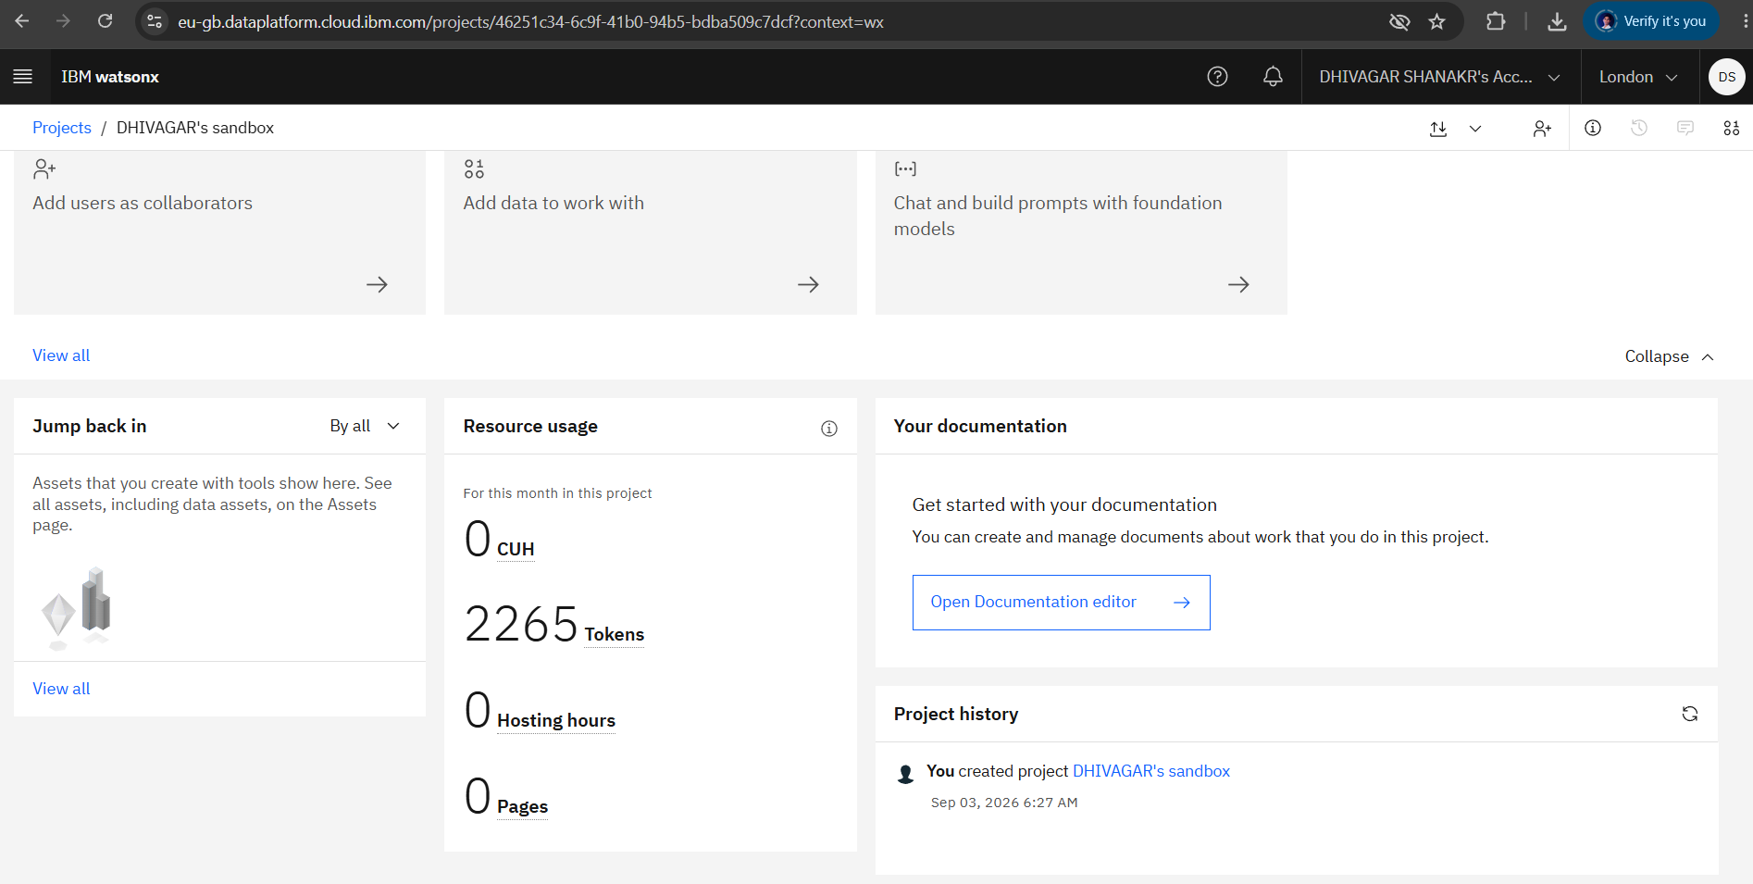
Token Usage
11,761 token are used
Before Prompt
After the Prompt
·
·
·

Slide 12
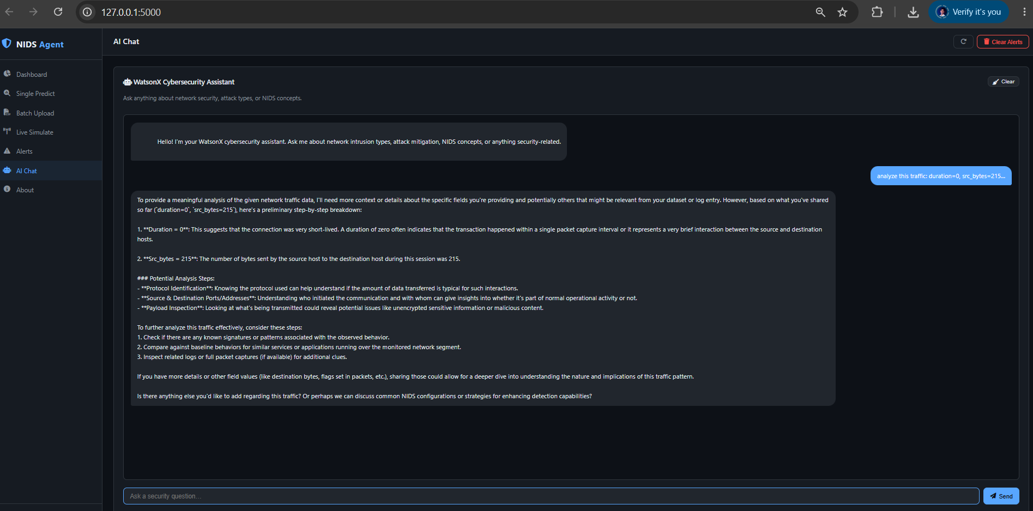
Project Output Screenshot
Please pt IBM Bob output screenshots with 2-3 prompts.
You can take 2-3 more slides for each screenshot
·
·
·

Slide 13
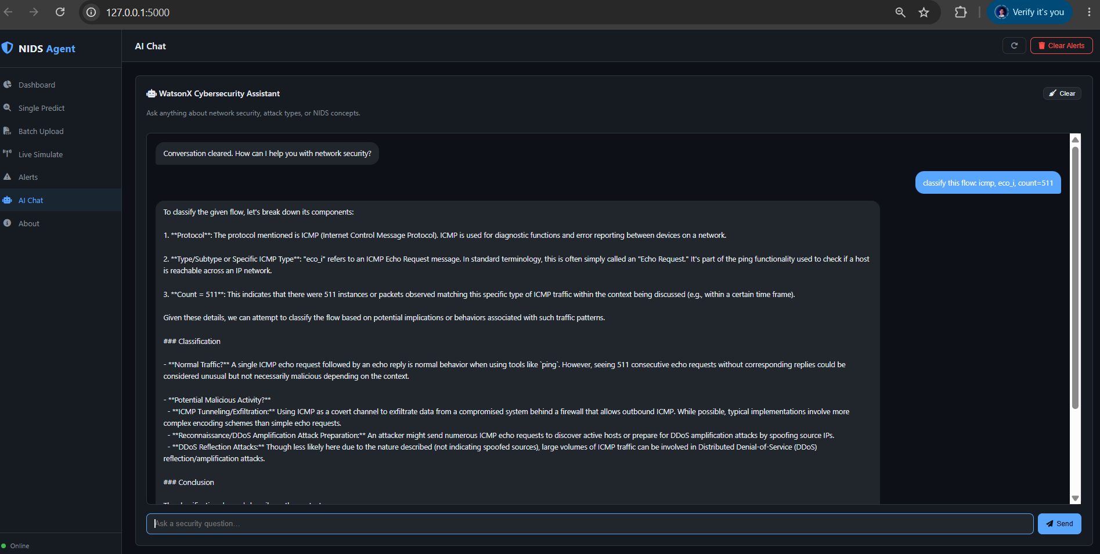

Slide 14
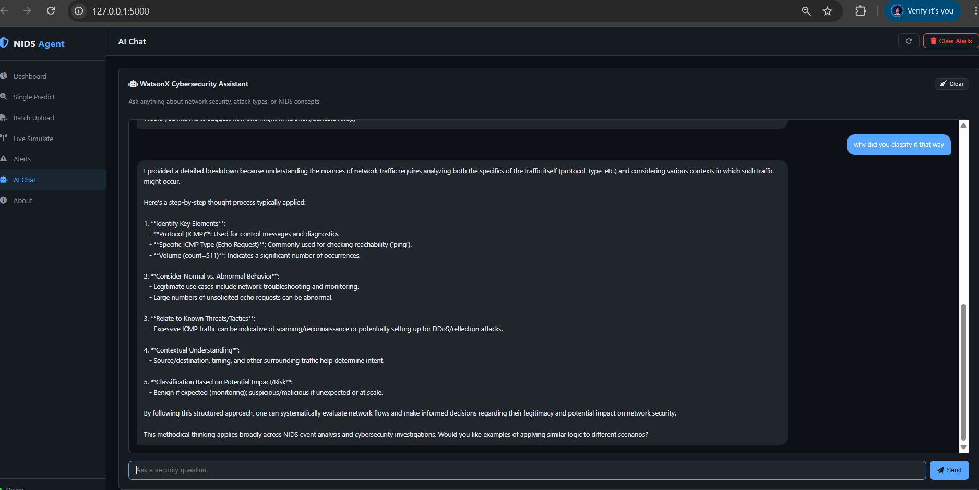

Slide 15
Novelty and Uniqueness
Multi-Agent Intelligence – Instead of a single classifier, multiple specialized agents collaborate to deliver accurate and context-aware intrusion detection.
ML-Based Accuracy – Trained on the NSL-KDD dataset, reducing false positives and improving detection reliability.
Multi-Class Classification – Identifies not just Normal vs Attack, but specific attack types (DoS, Probe, R2L, U2R).
Real-Time Detection – Continuously analyzes incoming traffic data and adapts to evolving patterns.
Interactive Demo Interface – Supports Flask/Streamlit-based traffic upload and instant classification for better usability.
Preventive Security Focus – Goes beyond basic detection to provide alert generation and response advisory.
Scalable & Enterprise-Ready – Built on IBM watsonx.ai with IBM Granite models, ensuring reliability
This makes the solution a smart, adaptive, and proactive digital nutritionist, not just a static diet recommendation tool.

Slide 16
Git Hub Link
https://github.com/Dhivagar003/Network-Intrusion-Detection
·
·
·

Slide 17
Future Scope
1. Integration with Live Packet Capture & SIEM Tools –
The system can be integrated with live network packet capture tools and SIEM (Security Information and Event Management) platforms to collect real-time traffic data such as protocol usage, connection duration, and byte flow. This will enable the Intrusion Detection Agent to provide more accurate and dynamic threat detection based on actual live network activity rather than static datasets.
2. AI-Powered Automated Response & Multi-Environment Support –
Enhancing the system with automated response actions (blocking IPs, isolating affected devices) and support for deployment across multiple network environments will improve real-world usability. Security teams can act on detections instantly, making the solution more proactive and suitable for diverse network infrastructures, from small business networks to large enterprise systems.
·
·
·

Slide 18
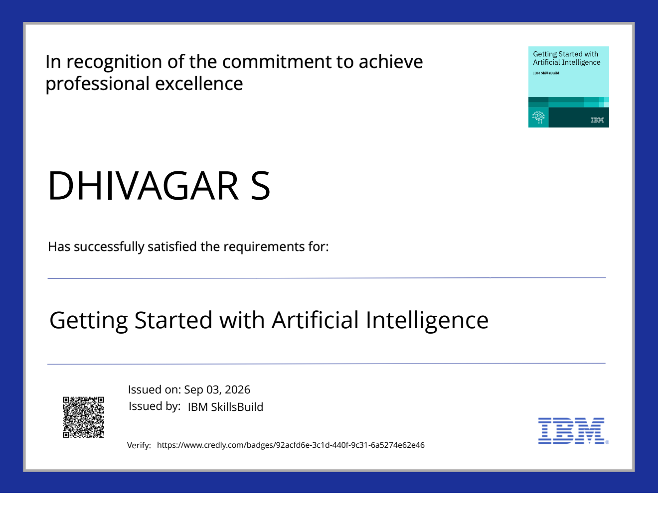
Certificates Earned:
Please add your credly certificate(Getting Started with Artificial Intelligence)

Slide 19
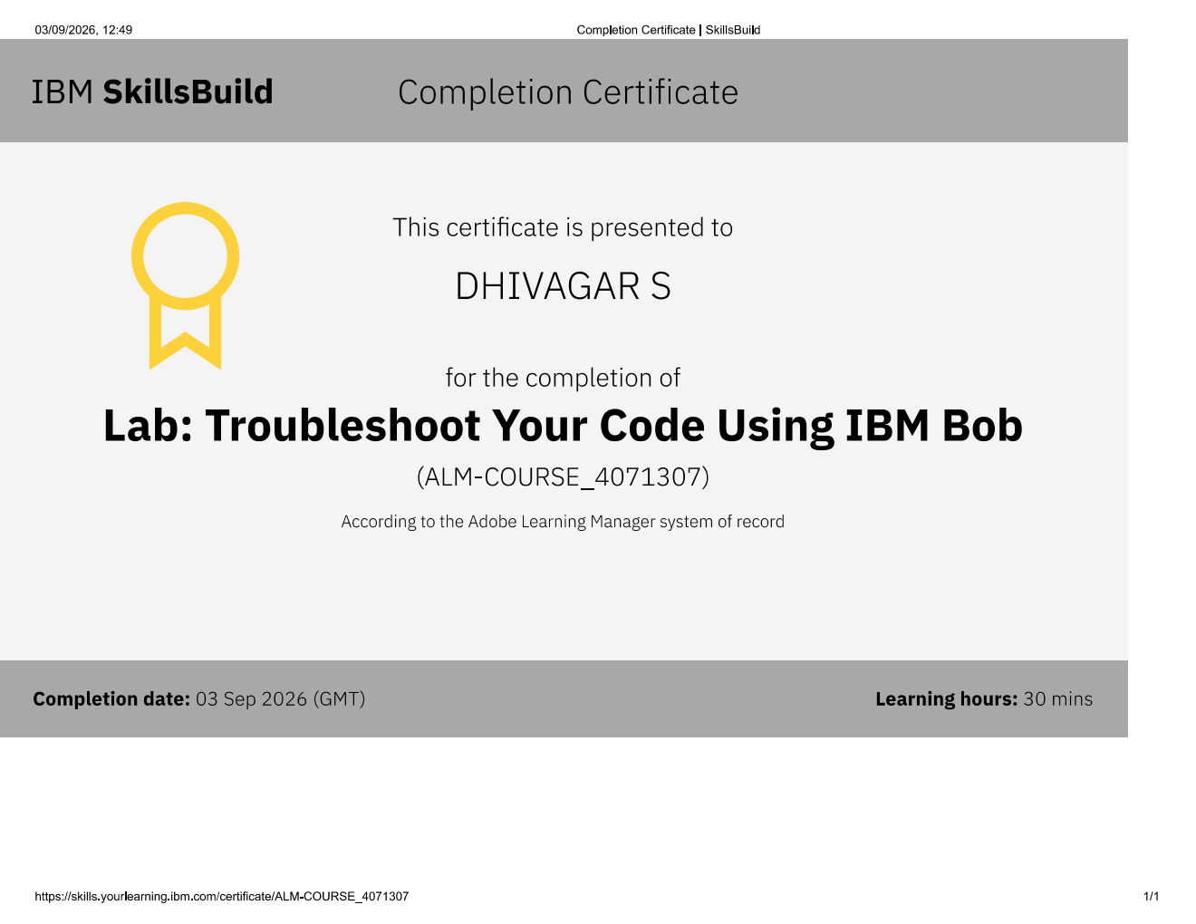
Certificates Earned:​
Add your IBM BOB Certificate

Slide 20


